Slide 1
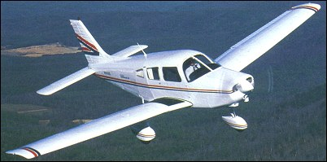


Partial Power Loss – Instructor Guide to Implementation
HBAH/SC
1 October 2025

Slide 2
PART 1:
BACKGROUND

Slide 3
Integrated into TEM across existing training
1 October 2025:
Partial power loss training is mandatory in:
PPL syllabus (Exercises 6, 12/13, 16)
Skills tests and proficiency checks
Hour with instructor/refresher training

Slide 4
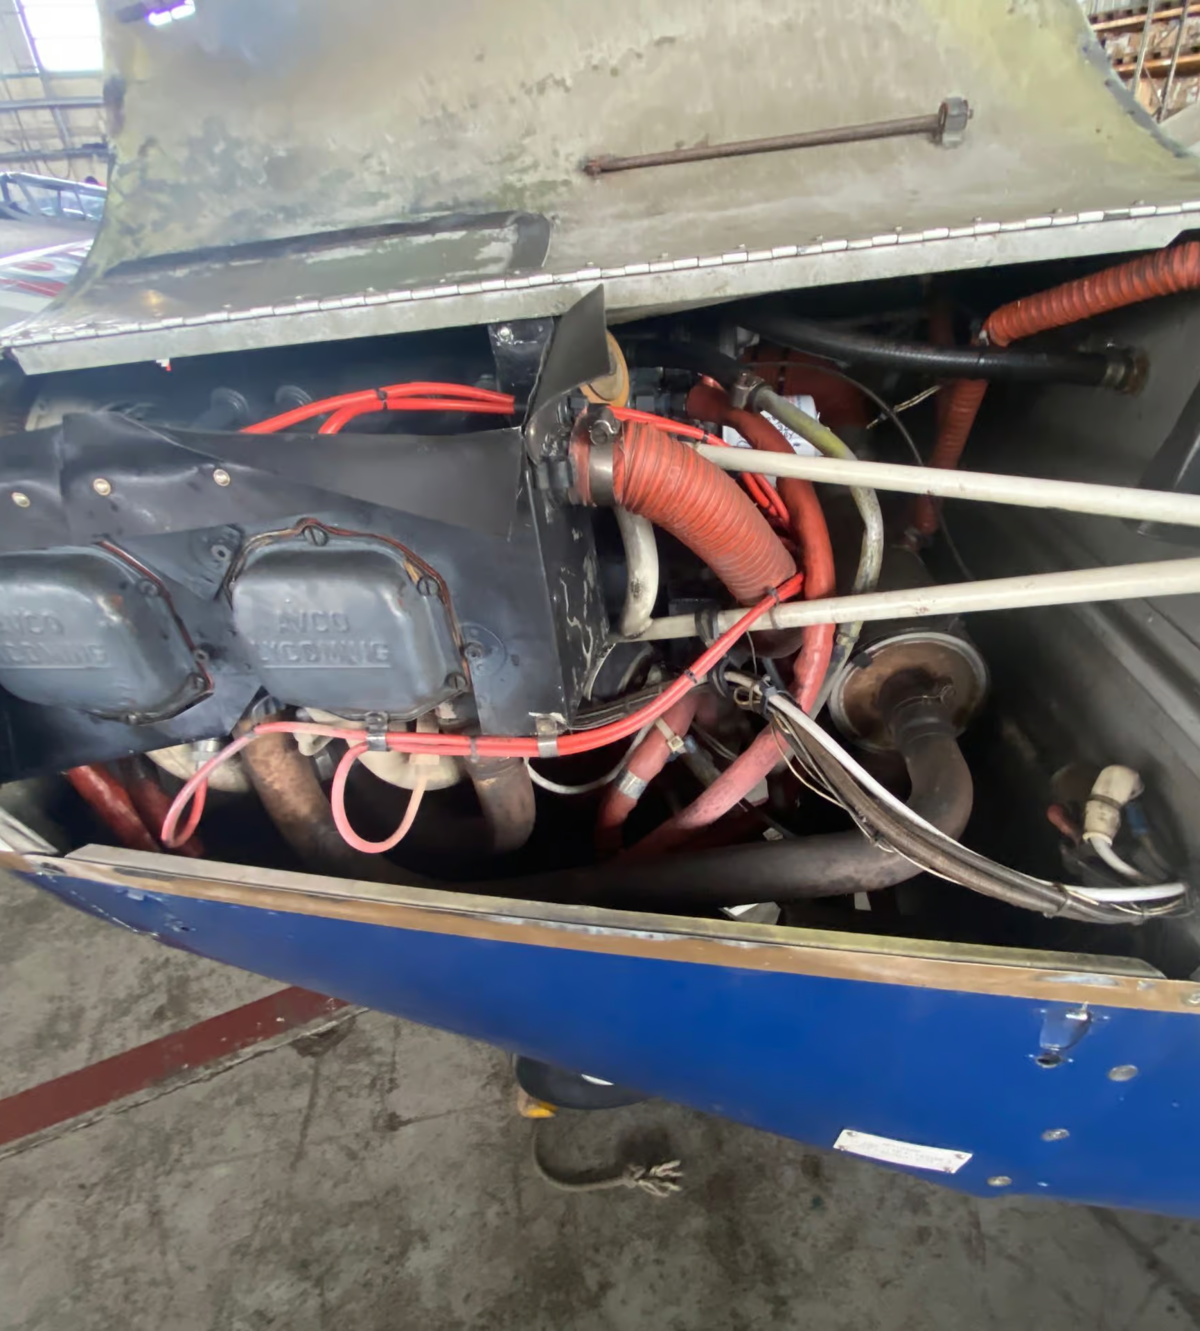
Partial engine power loss is more complex and
more frequent than a complete engine power loss.

Slide 5

Why is it more complex?
Many causes and variables
May be insidious
Startle effect (4 seconds)
More choices
Complex, time critical decisions - under stress
"Mid-range power" creates false confidence
Lack of training … until now

Slide 6
Partial power loss occurrences have a very broad range of causes and characteristics.
Examples include, but are not limited to:
mechanical discontinuities within the engine
restricted fuel or air flow or limited combustion in the engine
fuel starvation,
fuel exhaustion,
spark plug fouling.
primer not locked (rough running)
mechanical blockage of the engine controls (stuck throttle cable).

Slide 7
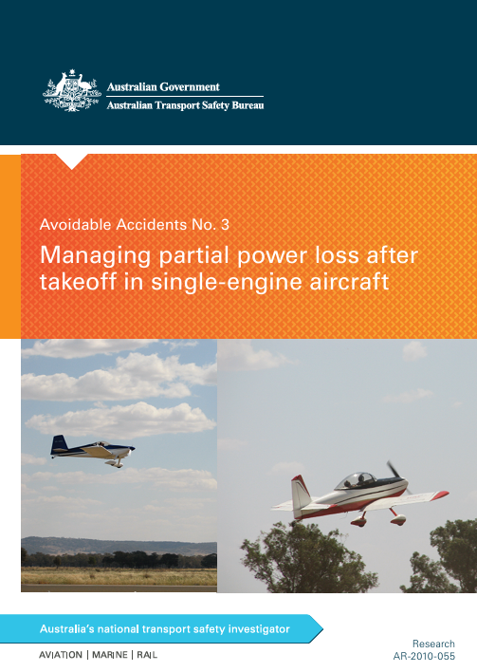
More frequent: The Statistical Reality
Australian Transport Safety Bureau Data (2000-2010)
Partial power loss:
242 occurrences,
9 fatal accidents
Complete engine failure:
75 occurrences,
0 fatal accidents
Partial power loss is 3x more likely than complete failure

Slide 8
Learning from Australia: The ATSB Approach
Key Insights
"Most fatal accidents resulted from pilots taking no clear action"
70% of "no action" cases resulted in loss of control
Only 8 out of 232 "decisive action" cases resulted in loss of control
Critical Finding: The most dangerous scenario is "mid-range power loss"
Enough power to create options
Not enough power to guarantee success
Creates decision paralysis

Slide 9
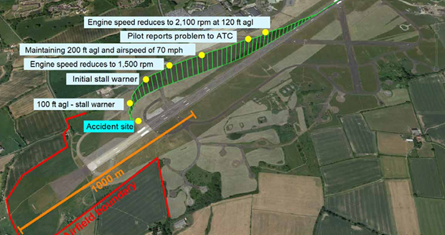
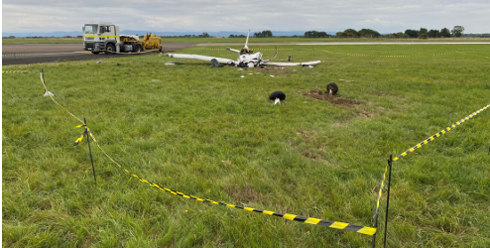
The UK Context: Why Change Now?
AAIB Findings
Series of partial power loss accidents with preventable outcomes
G-BBSA case study: RPM reduction → attempted turnback → stall/spin
Pattern emerging: pilots focusing on diagnosis rather than aircraft control

Slide 10
UK CAA Response
Safety Recommendation Implementation:
Mandatory syllabus changes (1 Oct 2025)
Skills test requirements updated
Examiner handbook amendments
Integration with existing TEM framework

Slide 11
TEM Integration: Where Partial Power Loss Fits
Existing TEM Topics and Partial Power
Threat identification: Engine anomalies, environmental factors
Error management: Decision-making under uncertainty
Undesired aircraft states: Partial power creates unique UAS
Risk assessment: Dynamic situation requiring constant re-evaluation
New TEM Element: "Power Reliability Assessment"
Teaching students to quickly assess whether available power is trustworthy

Slide 12
PART 2:
HOW and WHERE

Slide 13
Progressive Training Philosophy
Core Principle: Experience-Based Response
Low experience: Treat as complete failure (reduce variables)
Higher experience: Consider options but maintain failure readiness
All levels: Fly the aircraft first, diagnose second
"Option 1, Option 2, Option 1" Framework
Option 1: Land straight ahead/in the immediate area
Option 2: Use remaining power to reach better landing site
Always prepared for Option 1: Engine may quit completely

Slide 14
Exercise 6: Straight and Level
(Foundation building)
NEW ELEMENT: Minimum Power Determination
Objective: Student determines minimum power required for level flight at best glide speed
PA28 Warrior Specific:
Best glide speed: 73 KIAS
Establish level flight at 73 KIAS
Reduce power until altitude cannot be maintained
Note RPM (typically ~2000-2100 RPM in Warrior)
Instructor Standardization Notes:
Don't overcomplicate with multiple speeds at this stage
Best glide speed approximates minimum sink speed sufficiently
Creates "power benchmark" for future scenarios
Practice at different weights/CG positions

Slide 15
Exercise 12/13: Circuit Emergencies
AMC1 FCL.210 PPL(A) Training course
(xvii) Exercise 12/13: Emergencies:
(A) abandoned take-off (RTO) and reasons for doing so;
(B) engine failure after take-off including partial loss of power;
(C) mislanding and go-around;
(D) missed approach.
Note: If partial loss of power is not taught prior to first solo, it should be addressed during circuit consolidation flying

Slide 16
Exercise 12/13: Circuit Emergencies
(Building Blocks)
Partial Power After Take-off
Initial Training (pre-first solo):
Close throttle, execute engine failure after take-off
Why This Approach?
Low experience pilots lack decision-making skills under stress
High risk of stall/spin if attempting to maintain altitude
Consistent with existing EFATO training
Reduces cognitive load

Slide 17

PA28 Warrior Considerations:
• Low climb performance even with full power
• Any power loss significantly impacts climb capability
• Better to use "extra" glide distance from partial power than risk stall

Slide 18
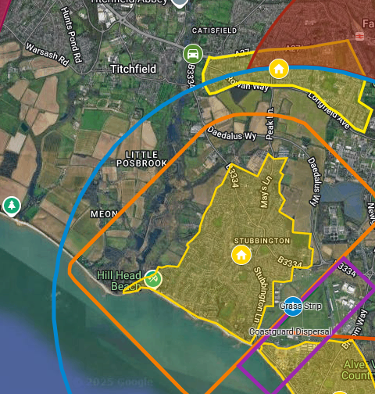
Exercise 12/13:Partial Power in Circuit (Later Training)
Downwind/Base: Close throttle, execute glide approach to suitable landing area
May reach runway if geometry permits
May require landing in field with 180° turn into wind
No attempting to "stretch" the circuit

Slide 19
Exercise 16: Practice Force Landings (Integration)
After PFL Training Complete introduce partial power cruise scenarios
Assessment Framework:
1. Can aircraft maintain altitude? (Reference Exercise 6 power setting)
2. Is remaining power reliable? (Consistent or surging?)
3. What are my landing options? (Continuously updated)

Slide 20
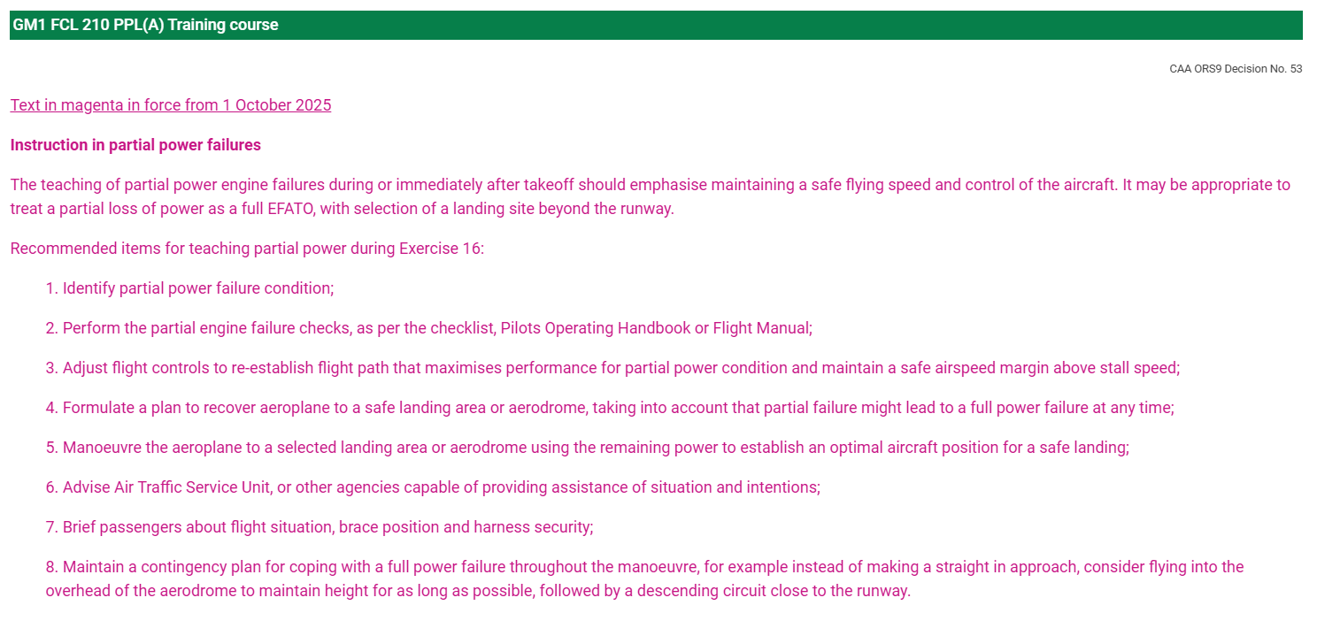

Slide 21
Partial Power En-route
Three Scenarios:
Scenario A: Power Sufficient for Level Flight
Scenario B: Gradual Power Loss/Unable to Maintain Altitude
Scenario C: Surging/Unreliable Power

Slide 22
Scenario A: Power Sufficient for Level Flight
Aviate
Control the aircraft
Navigate
Toward nearest airfield
Continuously identify suitable fields
Communicate
Pan as a minimum
Power off approach. DO NOT rely on partial power in the circuit
Assume complete failure imminent
Position overhead
Brief passengers

Slide 23
Scenario B: Gradual Power Loss/Unable to Maintain Altitude
Aviate
Control the aircraft
Navigate
Use remaining power to reach a suitable landing area
Continuously reassess
Communicate
Mayday call
Power off approach.
Assume complete failure imminent
Position overhead selected landing area
Brief passengers

Slide 24
Scenario C: Surging/Unreliable Power
Aviate
Control the aircraft
Close throttle
Establish glide
Communicate
Mayday call
Brief passengers
Treat as immediate engine failure
Land in best available area

Slide 25

PA28 Warrior Specific Considerations
Aircraft Characteristics
Climb Performance: Marginal even with full power
Glide Performance: 73 KIAS = approx 9:1 ratio
Power Requirements: ~2000 RPM typically minimum for level flight
Stall Characteristics: Gentle, but wing drop possible if uncoordinated
Common Scenarios in Training
1. Carb ice (most common in UK climate)
2. Partial blockage (mixture/fuel system)
3. Ignition problems (fouled plugs, mag issues)
4. Throttle cable restriction

Slide 26
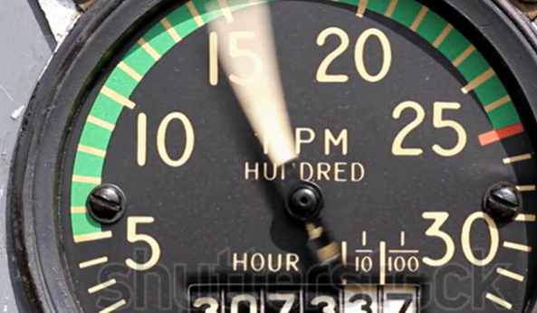
Power Settings for Training
Full failure simulation:
Idle power
Partial power simulation: 1800-2000 RPM (adjust for maintaining/losing altitude)
Surging simulation: Alternate between 1500-2200 RPM

Slide 27
Summary of Actions
Aviate first: Maintain glide speed, assess situation
Navigate: Identify landing options continuously
Communicate: Pan Pan minimum, Mayday if off-field landing certain
In all cases do not commence descent until well within glide range of selected landing area
PAX brief
Consider: Brief engine checks if time permits
Common Student Errors to Address
Attempting to diagnose at expense of aircraft control
"Stretching" glide with partial power
Fixation on return to departure airfield
Inadequate airspeed monitoring in turns

Slide 28
Assessment Criteria
Student Must:
Maintain control of the aircraft throughout
Make timely decisions appropriate to experience level
Demonstrate sound TEM principles
Show understanding of power reliability assessment

Slide 29

Training Experienced PPL Holders
The Challenge:
From 1 October 2025, all skills tests and proficiency checks must include partial power assessment.
Many current PPL holders never received this training.
Prior to test/check, they should receive ground and in-flight training, including the use of moving map displays

Slide 30
AMC1 FCL.740.A(b)(1)(ii)
Revalidation of class and type ratings (from 1st October 2025)
Before the training takes place, the instructor should hold a briefing with the candidate.
That briefing should include a discussion on the following:
  TEM with special emphasis on decision-making when encountering adverse meteorological conditions or unintentional IMC;
  navigation flight techniques, including use of VFR Moving Map devices, if used by the pilot;
  recovery strategies for different stall scenarios.
Flight training exercises should be based on the contents of the proficiency check, as deemed relevant by the instructor, and depending on the experience of the pilot. In any case, the flight training items should include exercises related to the recognition of and the recovery from the following scenarios:
  simulated loss or partial loss of engine power during different phases of flight;
  selection of different stall scenarios (as specified in Exercise 2.3 of the table in point (5) of Section B of Appendix 9)

Slide 31
Training Experienced PPL Holders
A format for the required training of Experienced PPL Holders will be produced, which will include the requirements of AMC1 FCL.740.

Slide 32
Key Messages for Experienced Pilots
"This isn't about learning new flying skills - it's about structured decision-making”
Builds on existing emergency training
Focus on threat and error management principles
Practice scenarios until decision-making becomes automatic

Slide 33
PART 3:
EXAMINER GUIDANCE

Slide 34
Skills Test Implementation (From 1 October 2025)
Assessment Integration
Not a separate test item
Integrated into Section 5 (General handling) or Section 6 (Abnormal procedures)
Examiner discretion on specific scenario
Should reflect "real world" likelihood
Recommended Test Scenarios: Initial PPL Skills Test
Circuit-based scenario (low experience, so basic decision-making expected)
Simple power reduction during circuit
Assessment: Close throttle, execute engine failure procedure
Pass standard: Maintains control, follows trained procedures

Slide 35
Proficiency Checks/Renewals
Cruise-based scenario (higher experience expected)
Variable power loss simulation
Assessment: Demonstrates decision-making process, maintains aircraft control
Pass standard: Shows structured approach, sound TEM principles
Examiner Standardization
Use discretion based on candidate experience
Focus on decision-making process, not specific outcomes
Brief candidate beforehand on general scenario
Debrief thoroughly - this is learning opportunity
Common Assessment Errors to Avoid
Over-assessing complex scenarios on basic candidates
Expecting "perfect" solutions - there often aren't any
Focusing on aircraft handling rather than decision-making
Not allowing time for thought process

Slide 36
General Principles to Teach
Maintain an airspeed not lower than best glide speed
Understand what RPM in your aircraft is sufficient to maintain altitude
Be ready for total power loss.
If you suffer partial power loss, first ask the question can I still climb?
If so, climb to a safe altitude, and if close to the airfield, fly a close-in circuit and land.
Don’t hesitate to make a PAN or MAYDAY call.
If time checklist diagnose
If partial power occurs on a cross country route, and you can maintain altitude, then proceed cautiously to the nearest airfield and position overhead for a power off landing. Be looking for fields along the way, in case the engine fails.
If you are not maintaining altitude, then a forced landing is inevitable, but the residual power gives you a little bit more choice and flexibility of location.

Slide 37
Useful links
Australian Transport Safety Bureau: Managing partial power loss after takeoff in single-engine aircraft
https://www.atsb.gov.au/sites/default/files/media/4115270/ar-2010-055_no3.pdf
AAIB GBBSA report:
https://assets.publishing.service.gov.uk/media/629f53c1d3bf7f036a31c70a/Grumman_AA-5_G-BBSA_07-22.pdf

